Slide 1
Translating Science, Translating Empire: The Michael Dodson Story

Slide 2
Introduction
Who is Michael Dodson?
Translating Science
Translating Empire
The Intersection of Science and Empire
Dodson's Impact
Challenges and Criticisms
Dodson's Legacy
Conclusion
Q&A

Slide 3
Introduction
Students, today I have the pleasure of introducing you to one of the most fascinating individuals in the world of science and culture. His name is Michael Dodson, and his work has had a profound impact on both fields.
Dodson's accomplishments are too numerous to list here, but I will attempt to give you a brief overview. He is a renowned scientist who has made groundbreaking discoveries in his field, and he is also a cultural translator who has helped bridge the gap between different communities around the world.

Slide 4
Who is Michael Dodson?
Michael Dodson is a renowned scientist and linguist who has made significant contributions to the fields of science and language translation.
He holds multiple degrees in both science and linguistics, and his work has been published in numerous academic journals and books. Dodson's research focuses on translating complex scientific concepts into accessible language for non-experts, as well as translating the language and culture of colonized peoples. His interdisciplinary approach has led to groundbreaking insights and innovations in both fields.

Slide 5
Translating Science
Michael Dodson's work in translating complex scientific concepts into accessible language is crucial for making science more approachable for the general public. By breaking down technical jargon and explaining difficult concepts in simpler terms, Dodson is able to bridge the gap between scientists and non-scientists.
Dodson's ability to translate science not only makes it easier for people to understand, but also helps to make science more inclusive. By making science accessible to a wider audience, Dodson is helping to break down barriers and promote diversity in the scientific community.

Slide 6
Translating Empire
Michael Dodson's work in translating the language and culture of colonized peoples is a significant contribution to the field of linguistics. By understanding the nuances of these languages, Dodson is able to shed light on the experiences of those who have been historically silenced.
Through his translations, Dodson is able to give voice to the stories and perspectives of colonized peoples, allowing them to be heard and understood. This work is not only important for historical accuracy, but also for promoting empathy and understanding across cultures.

Slide 7
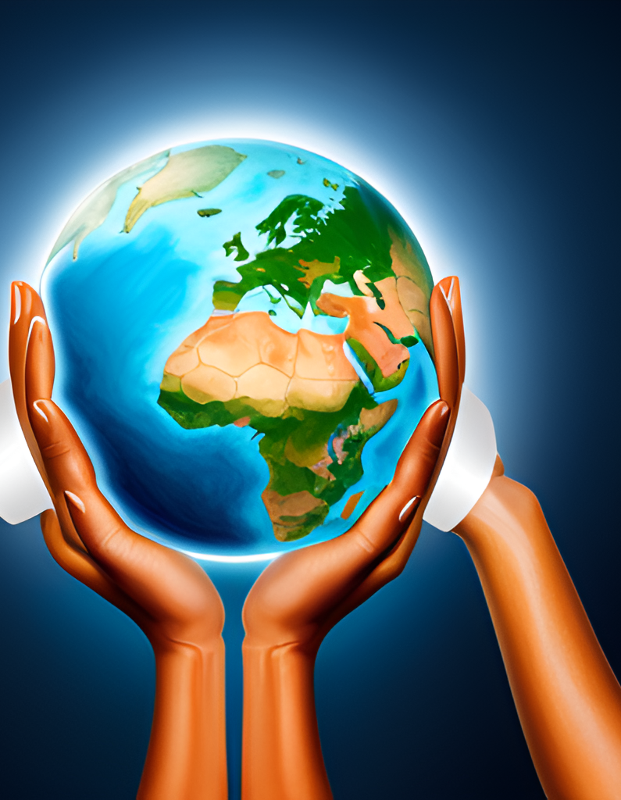
The Intersection of Science and Empire
Dodson's work in translating science and empire is a complex intersection that requires critical analysis. On one hand, his efforts to make scientific concepts accessible to a wider audience have the potential to democratize knowledge and empower marginalized communities. However, on the other hand, Dodson's work in translating the language and culture of colonized peoples can reinforce power imbalances and perpetuate colonialism.
It is important to consider the implications of this intersection and engage in ongoing conversations about the ethics of translation and cultural exchange. Dodson's work serves as a starting point for these discussions and highlights the need for greater awareness and sensitivity when engaging with different cultures and languages.

Slide 8
Dodson's Impact
Dodson's impact on the scientific and cultural communities cannot be overstated. His work in translating complex scientific concepts into accessible language has made science more approachable and understandable for people from all walks of life. Dodson's ability to bridge the gap between academia and the general public has helped to make science more inclusive and democratic.
In addition to his contributions to the scientific community, Dodson's work in translating the language and culture of colonized peoples has also had a significant impact. By helping to preserve and promote the languages and cultures of marginalized communities, Dodson has played a crucial role in promoting diversity and combating cultural erasure. His work has helped to create a more equitable and just society.

Slide 9
Challenges and Criticisms
One challenge to Dodson's work is the potential for oversimplification. Some critics argue that translating complex scientific concepts or cultural traditions into accessible language can result in important nuances being lost or misrepresented.
Another criticism is that Dodson's work may perpetuate a colonialist mindset by centering Western scientific knowledge and perspectives. Critics argue that this can reinforce power imbalances and marginalize non-Western ways of knowing.

Slide 10
Dodson's Legacy
Michael Dodson's legacy is one of bridging gaps and building connections. His work in translating complex scientific concepts into accessible language has made a lasting impact on the field of science communication, while his efforts to translate the language and culture of colonized peoples have helped to promote understanding and respect across cultural divides.
Dodson's legacy also includes his critical analysis of the intersection between science and empire. By exploring the implications of this intersection, he challenged researchers and policymakers to consider the ethical dimensions of their work and to strive for more equitable and just outcomes.

Slide 11
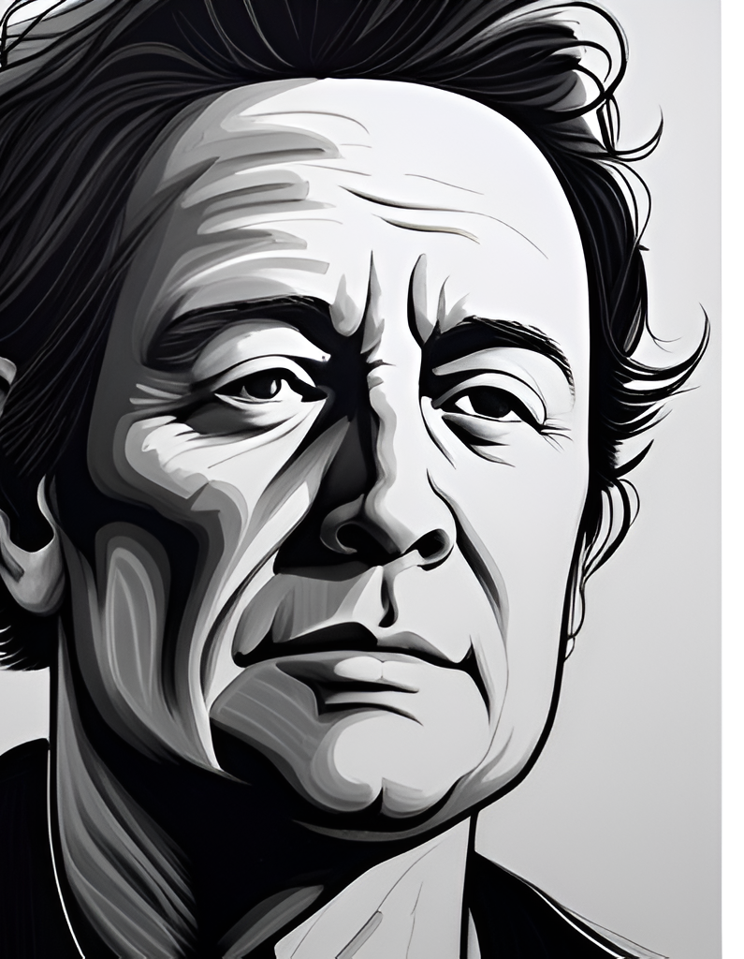
Conclusion
In conclusion, Michael Dodson's work has had a significant impact on both the scientific and cultural communities. His ability to translate complex scientific concepts into accessible language has made science more approachable for non-experts, while his work in translating the language and culture of colonized peoples has helped to bridge cultural divides. By exploring the intersection of science and empire, Dodson has shed light on the ways in which power dynamics shape our understanding of the world around us.
While there have been challenges and criticisms of Dodson's work, his lasting legacy is undeniable. He has inspired future generations to think critically about the role of science in society and to consider the ways in which language and culture influence our understanding of the world. We encourage you to explore Dodson's work further and to join us in celebrating his contributions to the scientific and cultural communities.

Slide 12
Q&A
Thank you for listening to my presentation on Michael Dodson's work. Now, I would like to open up the floor for questions and discussion. If you have any thoughts or comments on Dodson's impact on science and culture, please feel free to share them.
I encourage everyone to participate in this Q&A session and engage with each other. Let's have a meaningful conversation about Dodson's legacy and how it has shaped our understanding of the world around us.

